Slide 1

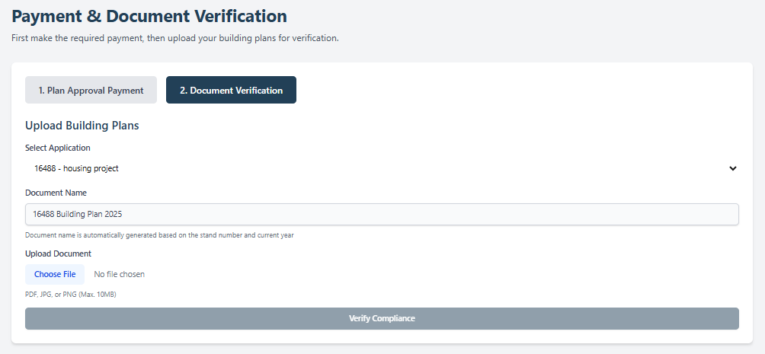
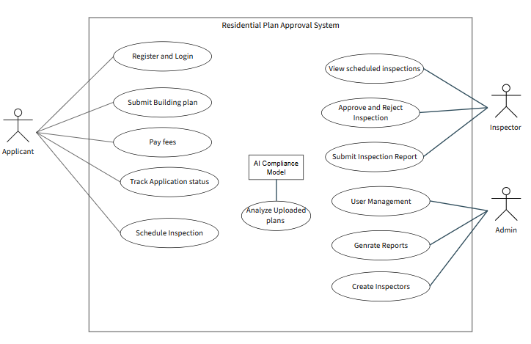
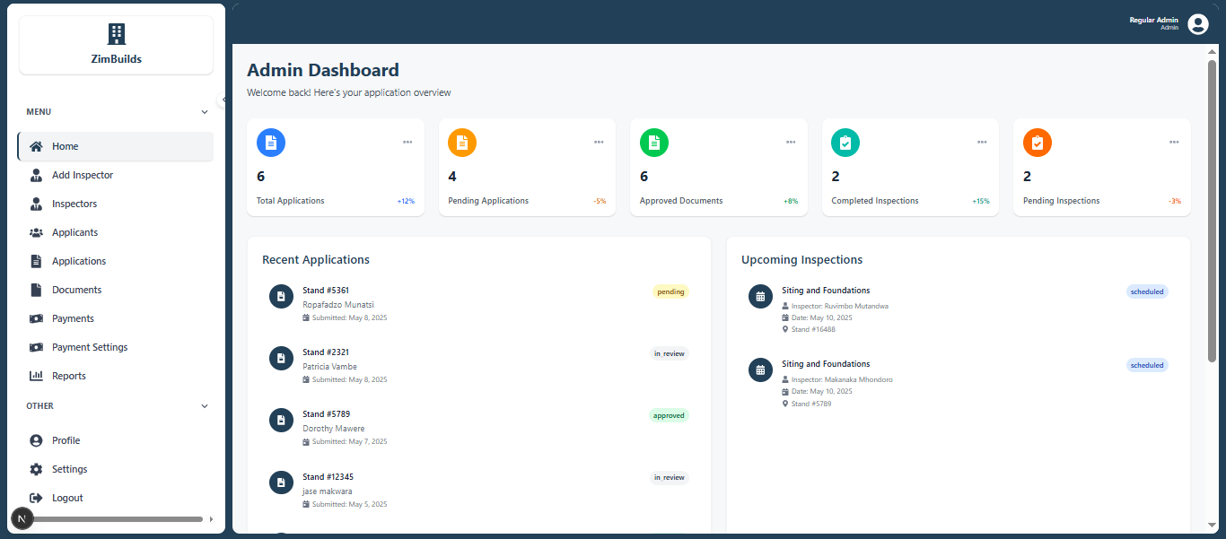
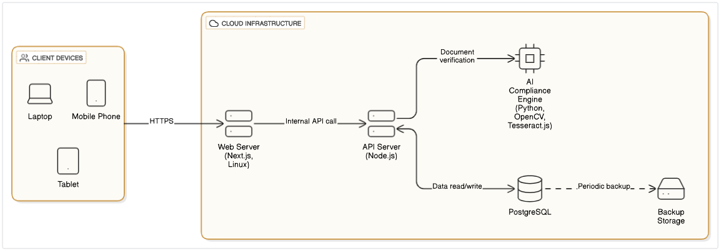
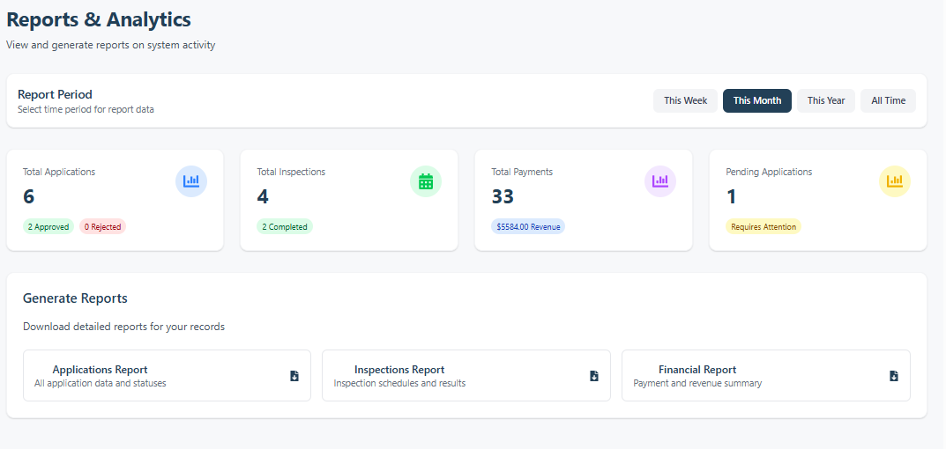
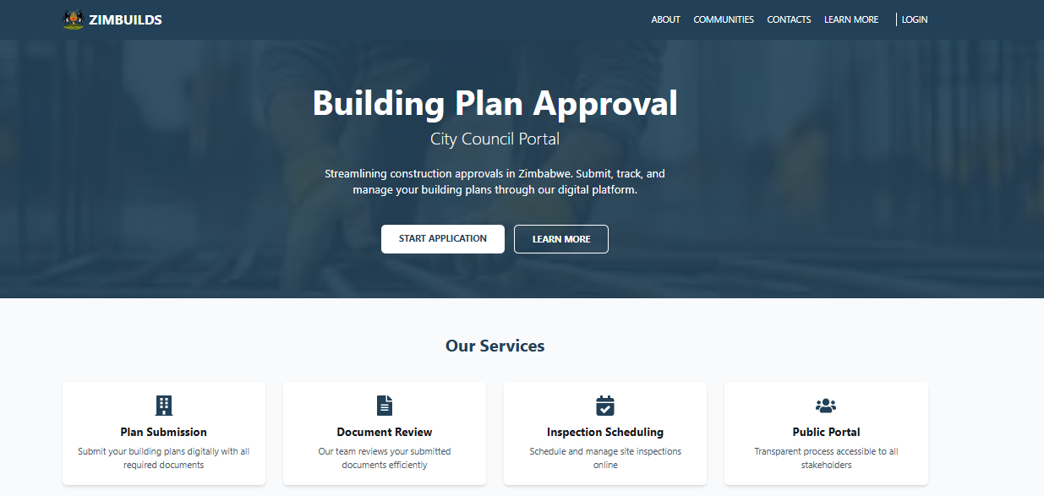
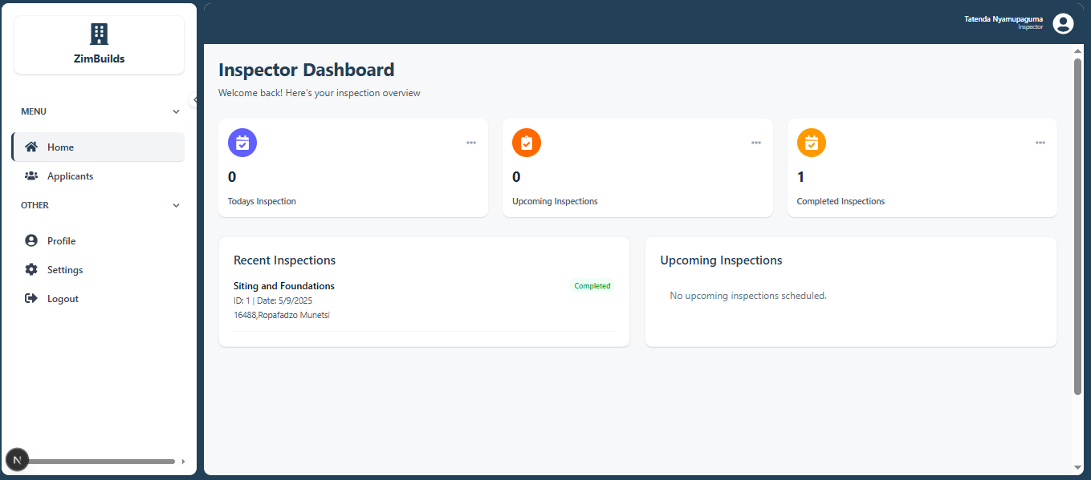
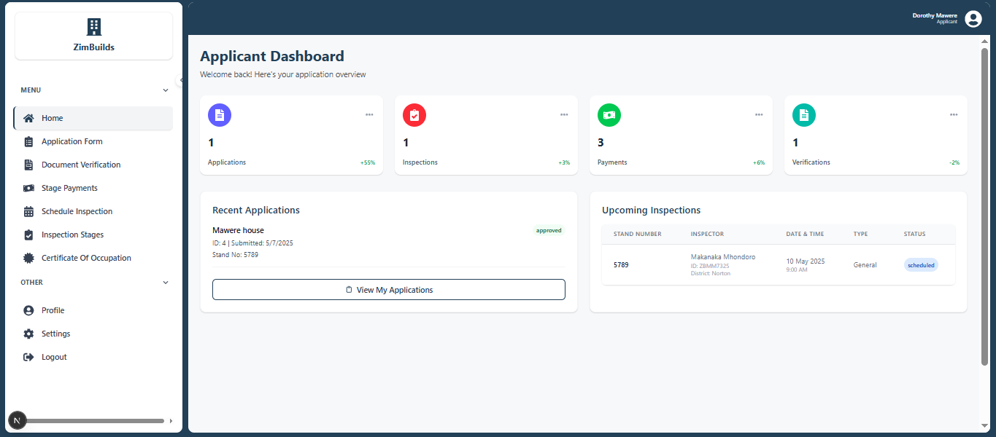
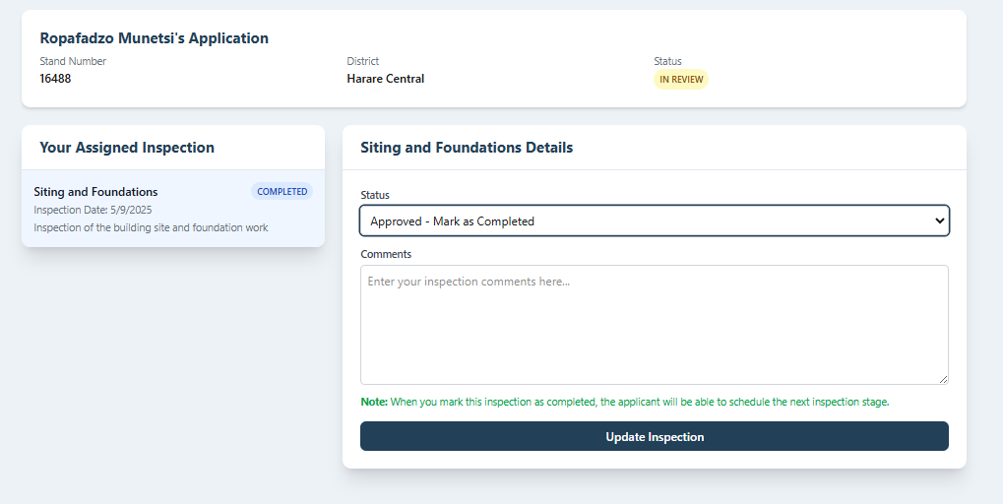
ZimBuilds Residential Plan Approval System(Web-Based)
Ropafadzo E Munetsi H210159W
Kenneth Chiworera(Supervisor)
Software Engineering Department
Abstract
Use Case Diagram
Conclusion
The platform offers a viable solution to the challenges Zimbabwean city councils and residents face. It utilizes AI-driven compliance checks for timely and standardized review of architectural plans, reducing human bias. It enhances transparency with real-time updates and allows applicants to track their application status. Inspectors benefit from automated scheduling and electronic report submissions, improving efficiency and accountability. With continued development, this system could transform the plan approval process and advance urban planning and public sector automation.
.
This project presents an innovative web-based residential plan approval system that utilizes AI-based compliance checking, automation, and centralized documentation storage to solve these problems. ZimBuilds is a comprehensive solution that deals with document uploading, plan review, inspection scheduling, and payment. It includes a web interface for inspectors, administrators, and applicants, aiming for transparency and application tracking.
.
Introduction
Zimbabwe's urbanization has been driven by economic growth, population rise, and rural-urban migration over the past two decades, leading to a high demand for residential buildings. However, the approval process for building plans remains largely manual and paper-based, requiring applicants to submit physical documents to multiple departments, which is cumbersome and time-consuming. Transitioning to a digital platform could streamline this process, reduce errors, and provide real-time updates for applicants and city council staff, ultimately enhancing consumer satisfaction.
Solution Architecture
Future works
The scholar plans to enhance the platform by integrating it with GIS and land registry systems for accurate property validation, extending access to multiple city councils across Zimbabwe, adding augmented reality support for real-time inspections, and incorporating blockchain technology for secure document verification
Objectives
Biography
The main objectives are as follows:
To develop a web app that streamlines the application process for plan approval.
To automate document verification using AI-powered document verification
To automate payment by integrating online payments
To implement automated inspector appointment scheduling
Ropafadzo Esalencia Munetsi is a final-year Software Engineering student at the Harare Institute of Technology. Worked on this project under the supervision of Mr. K. Chiworera, a lecturer and fellow degree holder in the same field
Screenshots from System
References
[1] M. Reyes-Carranza and D. Mbugua Muthama, “Urban sprawl and the automation of building control in the peripheries of Nairobi,” Urban Geography, 2025.
[2] D. Mandloi and V. Thakur, “IJSR-INTERNATIONAL JOURNAL OF SCIENTIFIC RESEARCH,” 2013.
[3] N. B. C. Buthelezi, G. O. Onatu, and C. O. Aigbavboa, “Planning approval of housing developments: case study of the city of Johannesburg and Tshwane metropolitan municipalities of South Africa,”
[4] H. Holmqvist and S. Papp, “A critical analysis of the building permit process at the Urban Planning Department in Gothenburg, Identification of improvement measures for a smoother internal process, Master’s Thesis in the Master’s Programme Design and Construction Project Management,” 2015
Methodology
The scholar utilized an Agile development approach, gathering regular feedback from stakeholders to align the platform with their needs. To achieve the objectives, various software tools and technologies were employed, including:
Programming Languages: JavaScript, Python
Frameworks: Next JS, Node JS
Database: PostgreSQL
AI Tools: OpenCV, Tesseract.js for document verification, a Pretrained model for document analysis, and compliance feedback

